Slide 1
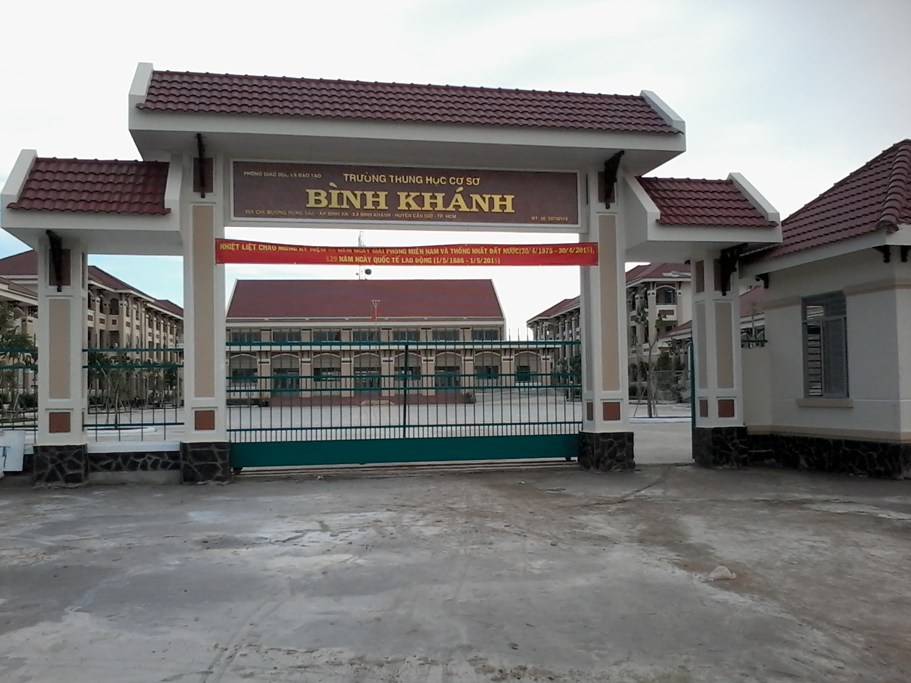
BINH KHANH SECONDARY SCHOOL
FRIENDS PLUS 6

Slide 2
UNIT 8: GOING AWAY
LESSON 7: WRITING

Slide 3
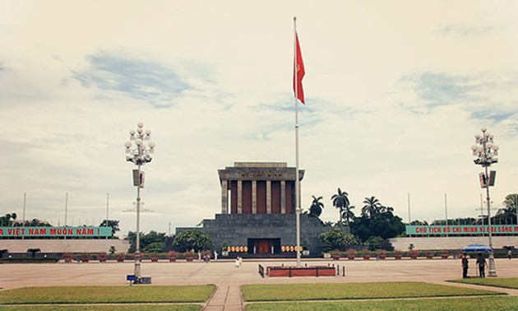
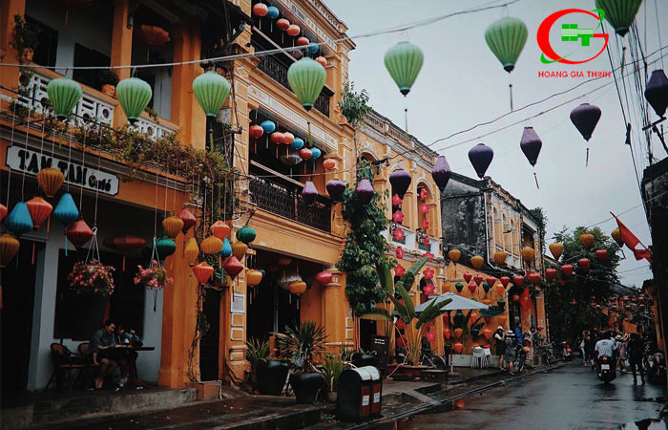
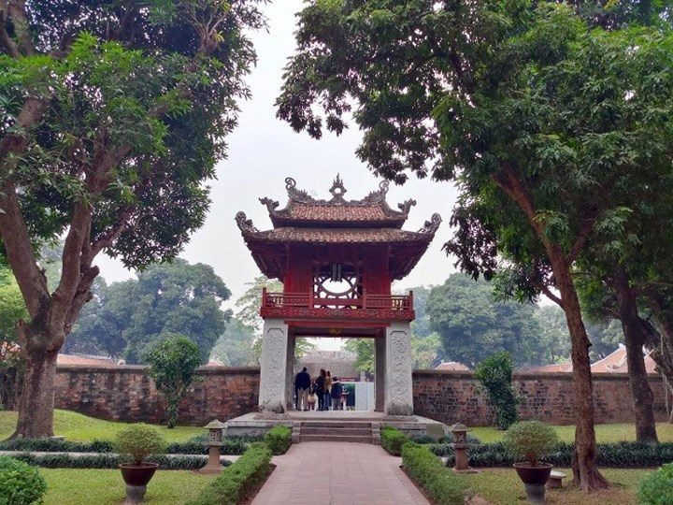
Ha noi city
Hoan Kiem lake
Ba Dinh Square
Where is this?
Ha Noi old Town
Temple of Literature

Slide 4
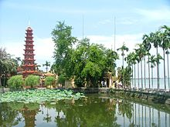
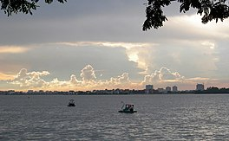
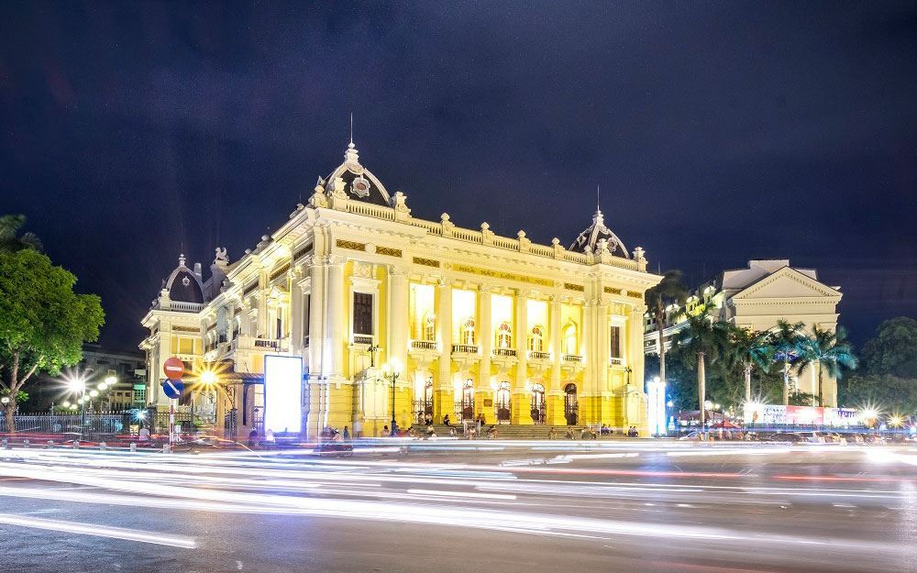
Where is this?
Ha Noi Big Church
Tran Quoc Pagoda
West Lake
Ha Noi Opera House

Slide 5
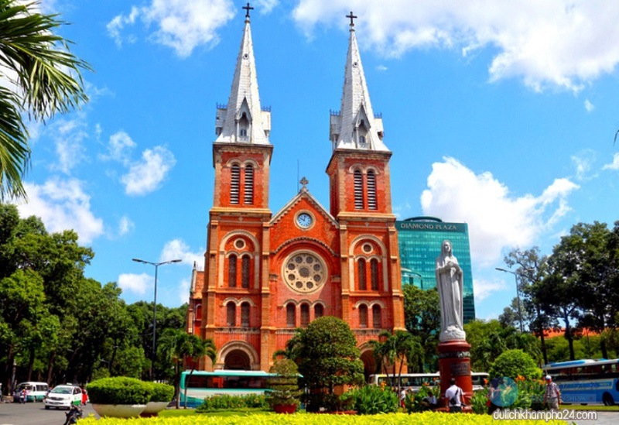
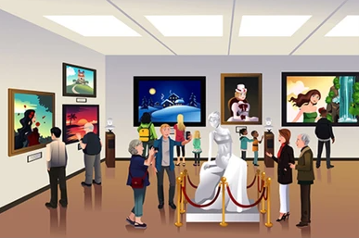
ANSWER THE QUESTIONS
What places are popular with tourists in your town or city?
Are there any interesting museums?

Slide 6
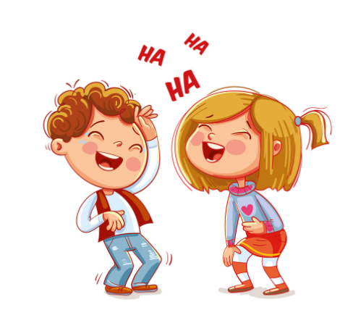
ANSWER THE QUESTIONS
What fun things can you do?
Are there any other towns or cities you could visit in your area?

Slide 7
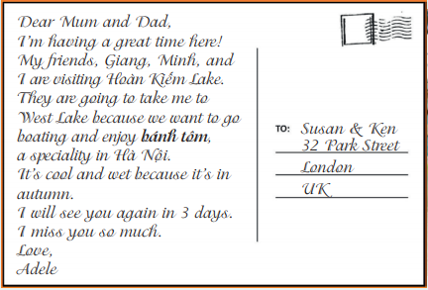
EXERCISE 1: Read the postcard. Where is Adele from? Where is she now? What is she doing?
1. Where is Adele from?
→ Adele is from the UK.
2. Where is she now?
→ She is in Hà Nội now.
3. What is she doing?
→ She is visiting Hoàn Kiếm Lake.

Slide 8
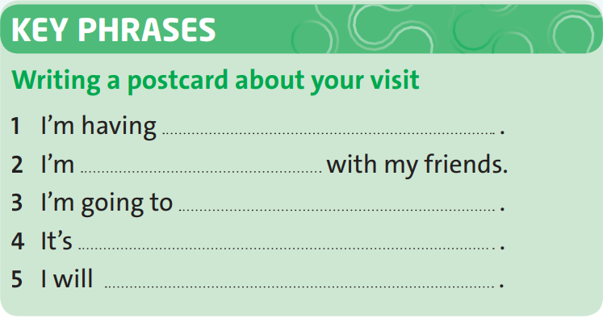
EXERCISE 2: Complete the Key Phrases. Then look at the postcard and check your answers.
a great time here
visiting Hoàn Kiếm Lake
to West Lake to go boating and enjoy bánh tôm
cool and wet
see you again in three days

Slide 9
EXERCISE 3: Study the example. Match sentences 1-5 with reasons a-e. Then combine the sentences using because.
1. I hope it will be hot tomorrow.
a. His dad works there.
b. We’re going to go away tomorrow.
2. We’re going to pack our suitcases.
c. It will be rainy on Saturday.
3. My brother wants to buy a guidebook.
d. He’s going to travel to Japan in the summer.
4. Samir lives in France.
5. We’re going to take our waterproofs.
e. I want to go to the beach.

Slide 10
Language point: BECAUSE
- Because is a subordinating conjunction. It shows the cause.
- We can combine two clauses using because.
eg:

Slide 11
EXERCISE 3: Study the example. Match sentences 1-5 with reasons a-e. Then combine the sentences using because.
Then combine the sentences using because.
Eg: It’s cool and wet because it’s in autumn.
1- e I hope it will be hot tomorrow because I want to go to the beach.
2-b We're going to pack our suitcases because we're going to go away tomorrow.

Slide 12
EXERCISE 3: Study the example. Match sentences 1-5 with reasons a-e. Then combine the sentences using because.
Then combine the sentences using because.
Eg: It’s cool and wet because it’s in autumn.
3-d My brother wants to buy a guidebook because he's going to travel to Japan in the summer.
4- a Samir lives in France because his dad works there.
5- c We're going to take our waterproofs because it will be rainy on Saturday.

Slide 13
EXERCISE 4: Optional activity – Writing.
Complete the sentences.
hope
1. I _____ it won’t rain.
going
2. The weather will be hot, so we’re _____ to swim or we’re _____ to have a picnic.
going
→ We use “I hope to” express a wish about the future, and we use “be going to” to talk about future plans.

Slide 14
* Optional activity
Optional activity: Writing.
Elicit how Adele begins and ends her email. Elicit other possible ways of ending an email, e.g. Write soon, Hope to hear from you soon, Looking forward to hearing from you, See you soon.

Slide 15
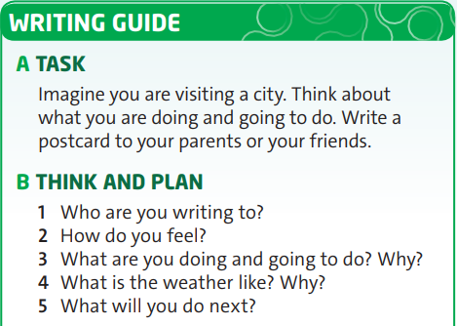
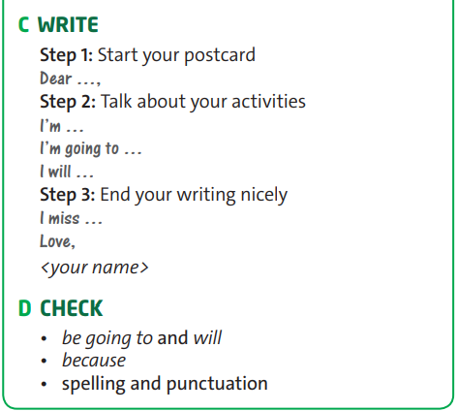
EXERCISE 5: Use it. Follow the steps in the writing guide.

Slide 16
- Learn by heart all structures.
- Write a postcard to friends/family,...
- Prepare for the next lesson: Culture

